Slide 1
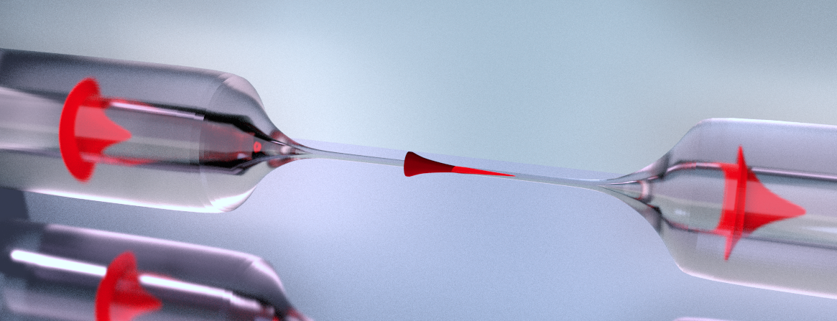
Observation of multimode strong coupling of laser-cooled atoms to fiber-guided photons
Martin Blaha, Aisling Johnson, Alexander Ulanov,
Jürgen Volz, Philipp Schneeweiss, and Arno Rauschenbeutel
Notes:
We talk about cavity QED today

Slide 2

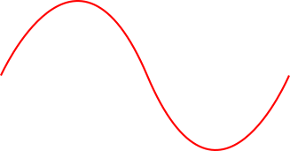
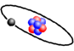
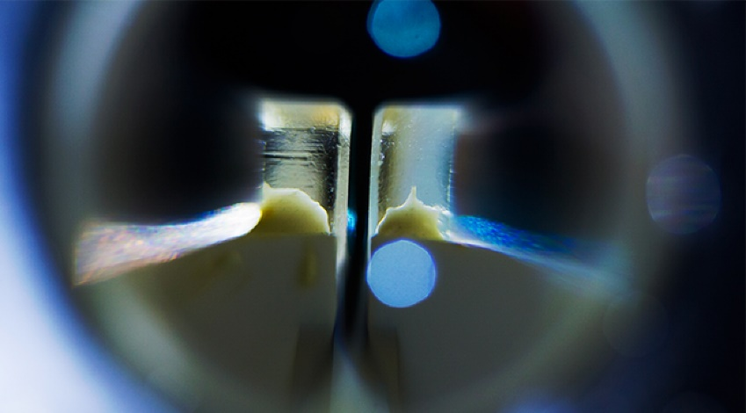
Cavity QED
Credit: E. Edwards/JQI
Notes:
We think of cavity as two mirrors
Like this
Tiny cavity in picture
What if we make it longer

Slide 3
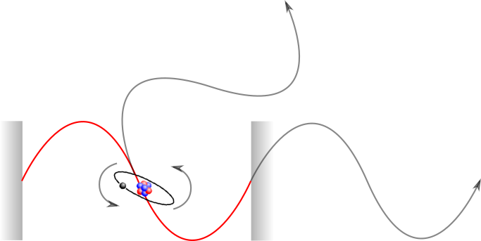

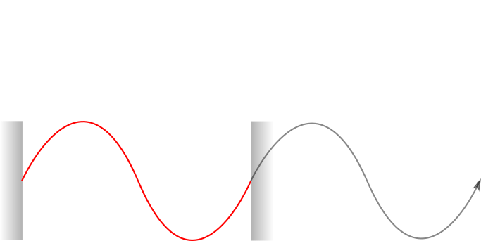
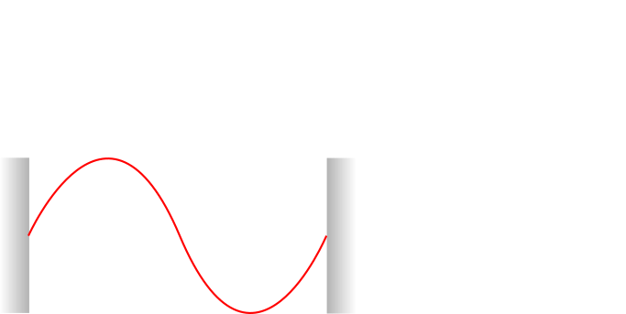
Cavity QED
γ
κ
g
κ cavity loss rate
γ spontaneous emission rate
g coupling rate
Notes:
Reminder of characterisation

Slide 4
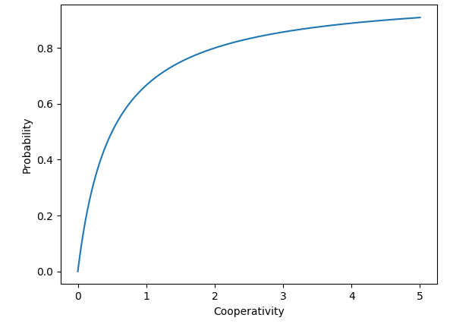
Cavity QED
Cooperativity
γ
g
κ
κ cavity loss rate
γ spontaneous emission rate
g coupling rate
Notes:
Talk about Cavities introducing all the values and cooperativity dont necessarily talk about strong coupling yet
For C use: probability for the atom to scatter back into the cavity!
g is a coherent decay rate into the resonator

Slide 5
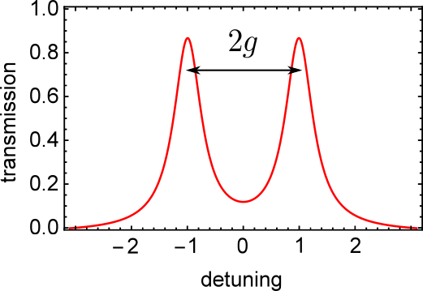
How to observe?
Mode splitting of resonance
→ Strong coupling
Notes:
If you see mode splitting you are in strong coupling regime -- > for given C > 1

Slide 6
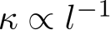
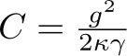

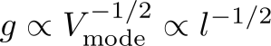
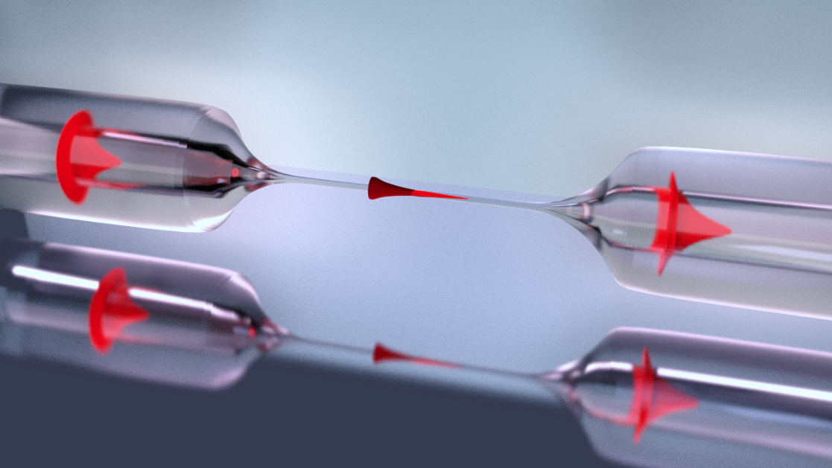
Length dependence of Cooperativity
Length dependence of resonator parameters
Length independent cooperativity
κ cavity loss rate
γ spontaneous emission rate
g coupling rate
Notes:
Back to length discussion:
Dependency of mode volume and lossrate with length
Any cavity becomes bad cavity
If waveguided cavity → length independent coop

Slide 7
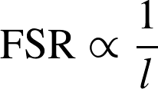
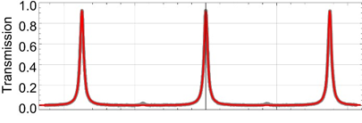
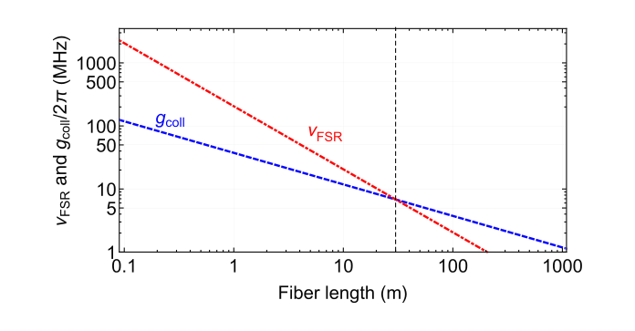
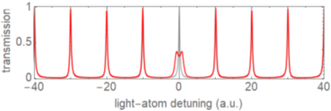
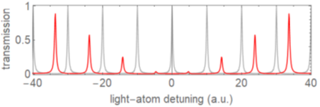
Free Spectral Range
FSR
g_{coll} > FSR
multimode strong coupling
Schneeweiss et al., Opt. Lett. 42, 85 (2017)
Notes:
Introduce FSR as a new parameter here
Longer L smaller FSR
For strong coupling cavity → transition into multimode strong coupling

Slide 8
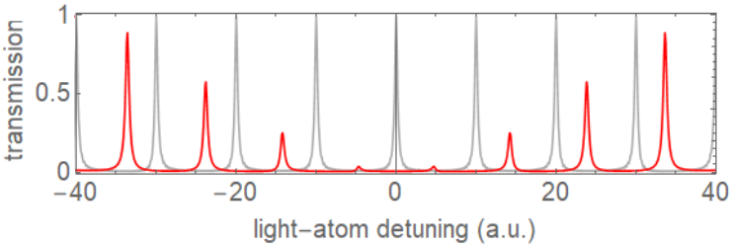
Multimode strong coupling
atoms interact strongly with many resonator modes
photon modes interact via the atoms
atoms and field do not interact instantaneously
Notes:
Explain plot
Hybridisation of resonator modes
This is new dynamics in CQED

Slide 9
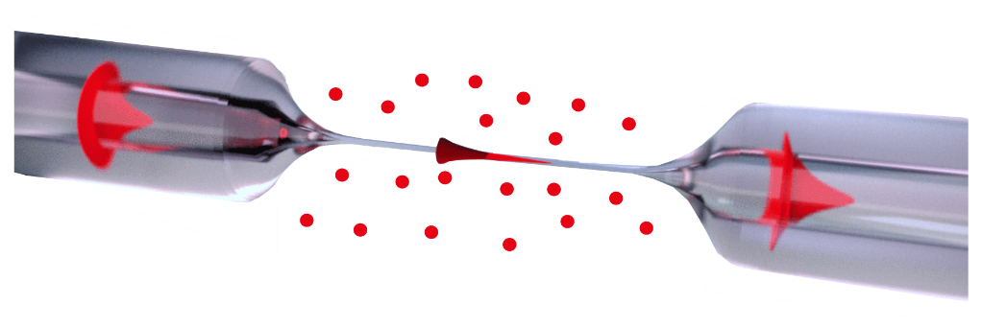
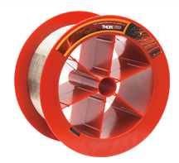
Fiber ring resonator
Optical nanofiber
30m fiber on a spool
Adjustable beam splitter
Notes:
Introduce Nanofiber

Slide 10
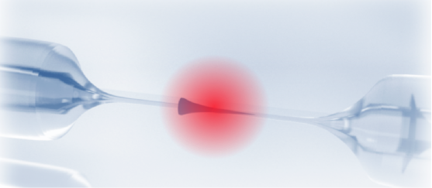
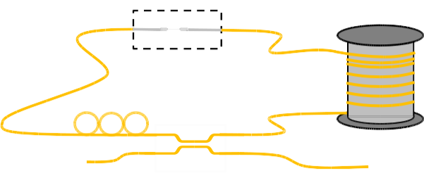

Implementation
Nanofiber in vacuum
thermally and acoustically insulated fiber spool
tunable in-/out coupling
single photon counter
Notes:
Setup and first characterisation

Slide 11
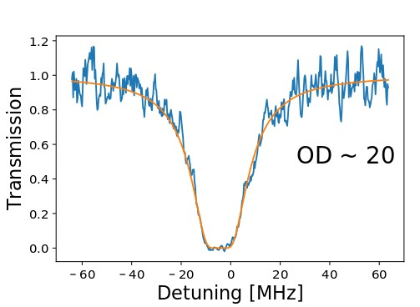
Interfacing the nanofiber with atoms
Magneto optical trap
→ reservoir of cold Cs atoms
Transmission spectroscopy → collective coupling
Switch resonator off → single round-trip of light
→ Multimode strong coupling regime
Notes:
Resonator OFF
Atoms ON
OD → coupling

Slide 12
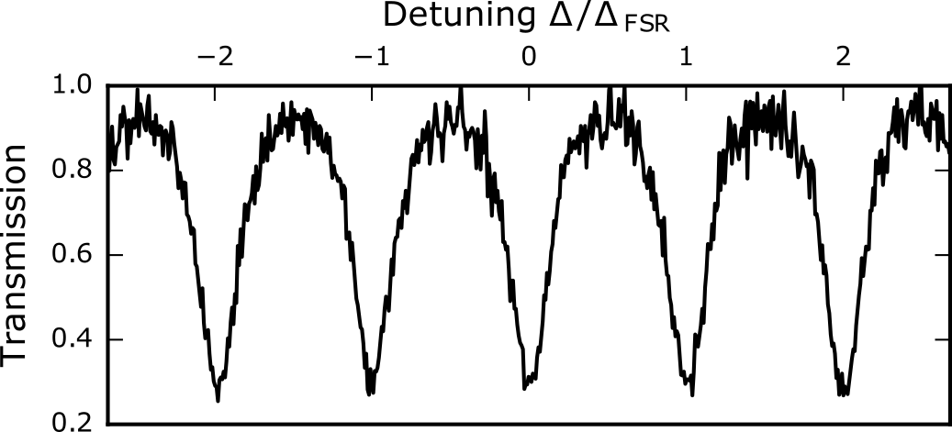
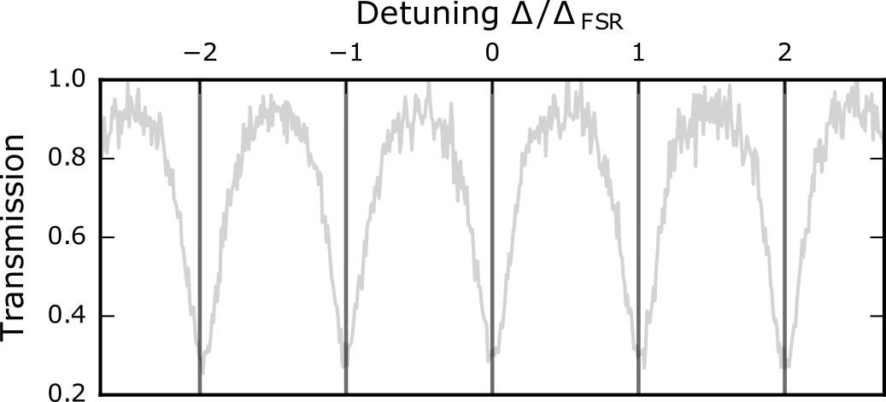
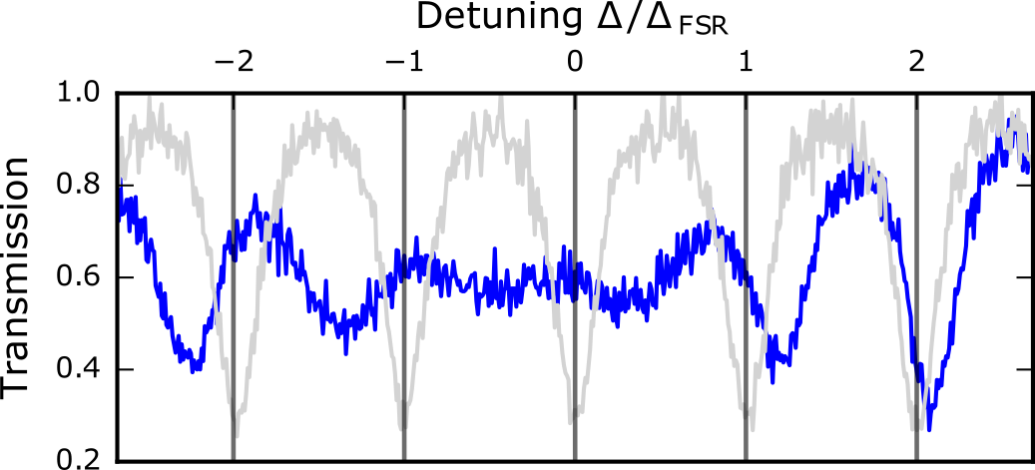
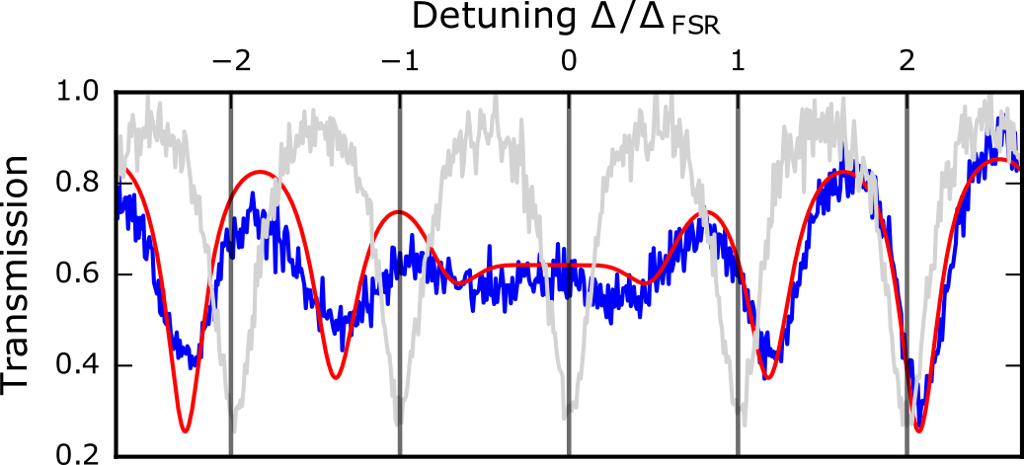
Transmission Spectrum
Switched resonator ON
laser – cavity detuning Δ/FSR
Transmission
empty resonator
resonator with atoms
simulation for gcoll = 12 MHz
Notes:
Show spectrum bit by bit

Slide 13
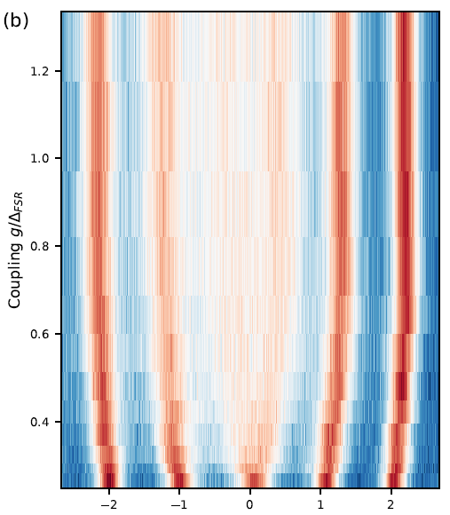

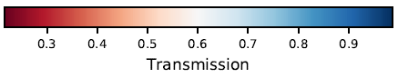
Spectrum
change number of atoms coupling to the resonator
Multimode-
strong coupling regime
„effective“ N ~ 100
coupling increases
reference spectrum
laser – cavity detuning Δ/FSR
Notes:
Say what the colors mean !
Changeing number of atoms changes coupling
Characterise transition from strong to MMSC

Slide 14
Temporal dynamics
res. light
BS
count coincidences
Notes:
Once we understood the steady state we would like to know more about the temporal dynamics of such a resonator
Second orde correlation measurements

Slide 15
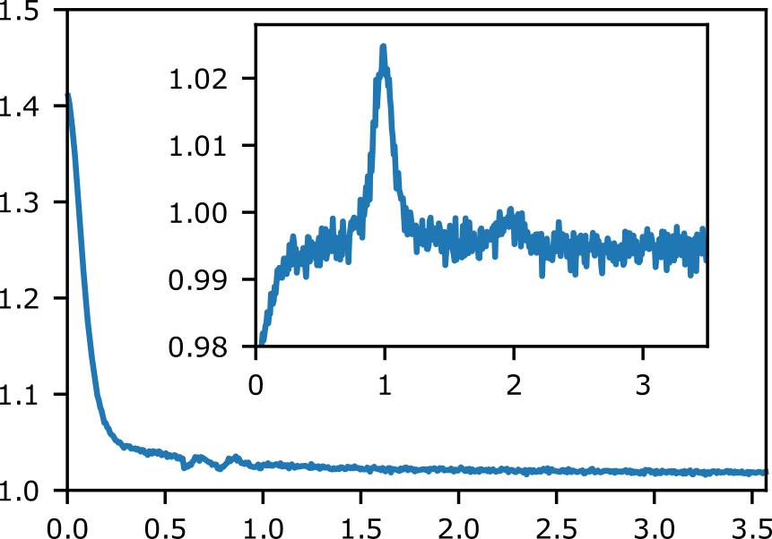
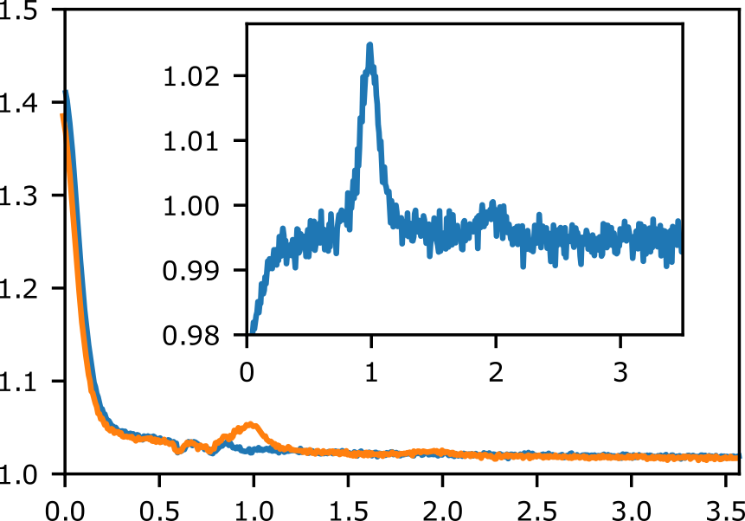
g⁽²⁾ measurements
External excitation of around 400 atoms
Comparision between resonator switched on and off
g⁽²⁾ (τ)
resonator OFF
resonator ON
Insert: divided g⁽²⁾
τ FSR
Revivals at roundtrip times
→ Photons travel as a pulse and thus couple to several resonator modes
Notes:
Photons travel as a pulse, they
couple to several modes making the photons a wavepacket
140ns roundtriptime

Slide 16

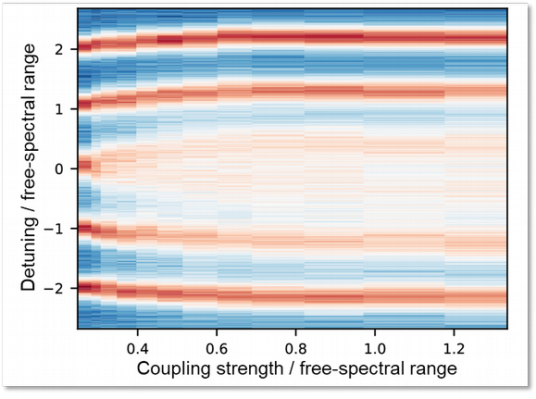
MMSC conclusion
Length independent cooperativity
Observation of multimode strong coupling
Observation of multimode dynamics in correlation measurements
Notes:
We could show that using an optical nanofife fiber ring resonator we could use length independend Cooperativity to go to MMSC
Show MMSC
Study the time dynamics of multimode resonator

Slide 17
Outlook
Next experimental steps
Trapping atoms in evanescent field of the nanofiber
Studying the interaction of photons in different modes
And then?
new type of photon-resonator dynamics
roundtrip time is not negligible
no instantaneous atom – cavity interaction
mode – mode interaction
Ideas?
Notes:
Trapping increases the interaction time! Of several ms
Interested in the new dynamics and mode mode interaction
Open for ideas

Slide 18
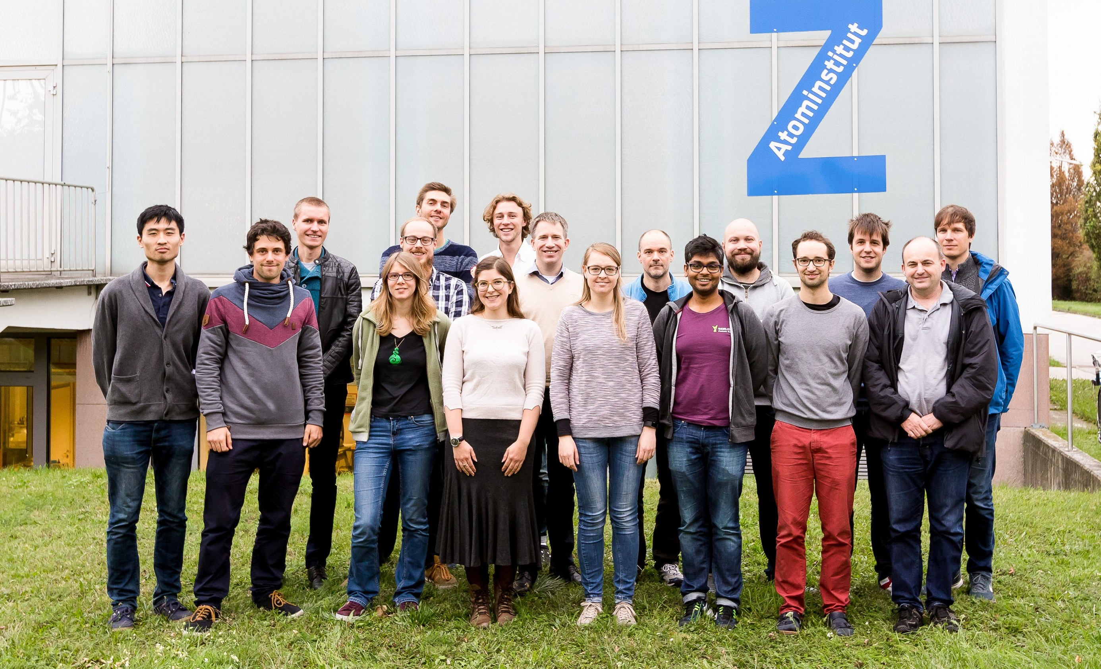




Thank you for your attention
A. Ulanov _{A. Johnson}
A. Rauschenbeutel
P. Schneeweiss
J. Volz
www.nanofiber.at

Slide 19
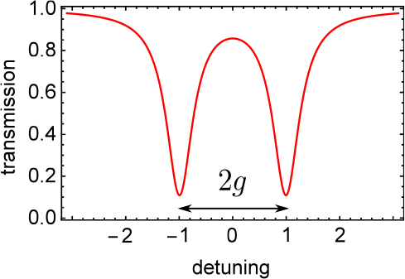

Outline
Multimode Strong coupling in CQED
opt. Nanofibers and Fiber-ring resonator
Measurements and Observations

Slide 20
Introduction
Multimode Strong coupling in CQED
opt. Nanofibers and Fiber-ring resonator
Measurements and Observations

Slide 21
Multimode Strong coupling in CQED
opt. Nanofibers and Fiber-ring resonator
Measurements and Observations

Slide 22
Key Aspects
Optical Nanofiber for enhanced coupling
Long Resonator for low FSR
Length – independent coupling strenght
Notes:
ONF for evanescent field coupling
Long resonator for small FSR
Independent coupling of length, hence no loss of g but increase with atoms

Slide 23
Multimode Strong coupling in CQED
opt. Nanofibers and Fiber-ring resonator
Measurements and Observations

Slide 24
Multimode QED
Multimode CQED
atoms emit into different cavity modes
Strongly coupled in a single round-trip “Superstrong coupling”
D.Meiser, P. Meystre, PRA (2006)

Slide 25
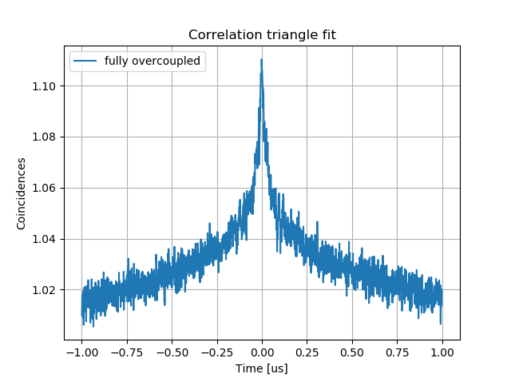
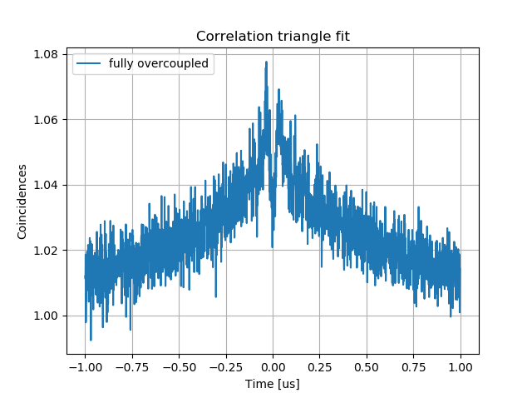
g(2) Measurements
Observe non-markovian behaviour of atom-resonator system
Investigate Nr of atoms conributing to the signal
Low OD case
Fully overcoupled regime → external excitation
Collection of fluorescence photons at the output
See K.P.Nayak et. al., Phys. Rev. A 79 (2009)
J.A.Grover et. al., Phys. Rev. A 92 (2015)

Slide 26
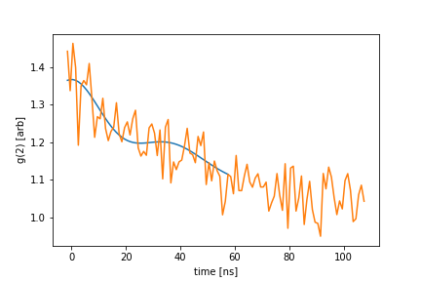
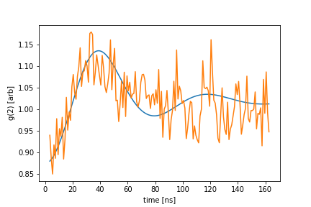
g(2) Measurements
5.8 atoms
1.44 atoms
OD per atom ~ 0.045
onset of MMSC for “effective” atom number ~ 100

